Slide 1

Branch and Bound
K. Rajesh Rao
Asst. Professor- Senior
Dept. of ICT, MIT

Slide 2
Contents
Basics
Comparison with Backtracking
0/1 Knapsack
Max Clique
Travelling Salesperson Problem (TSP)

Slide 3
Branch and Bound
Basics
Comparison with Backtracking

Slide 4
Ways to select the next E-node
First In, First Out
Least cost or Max Profit

Slide 5
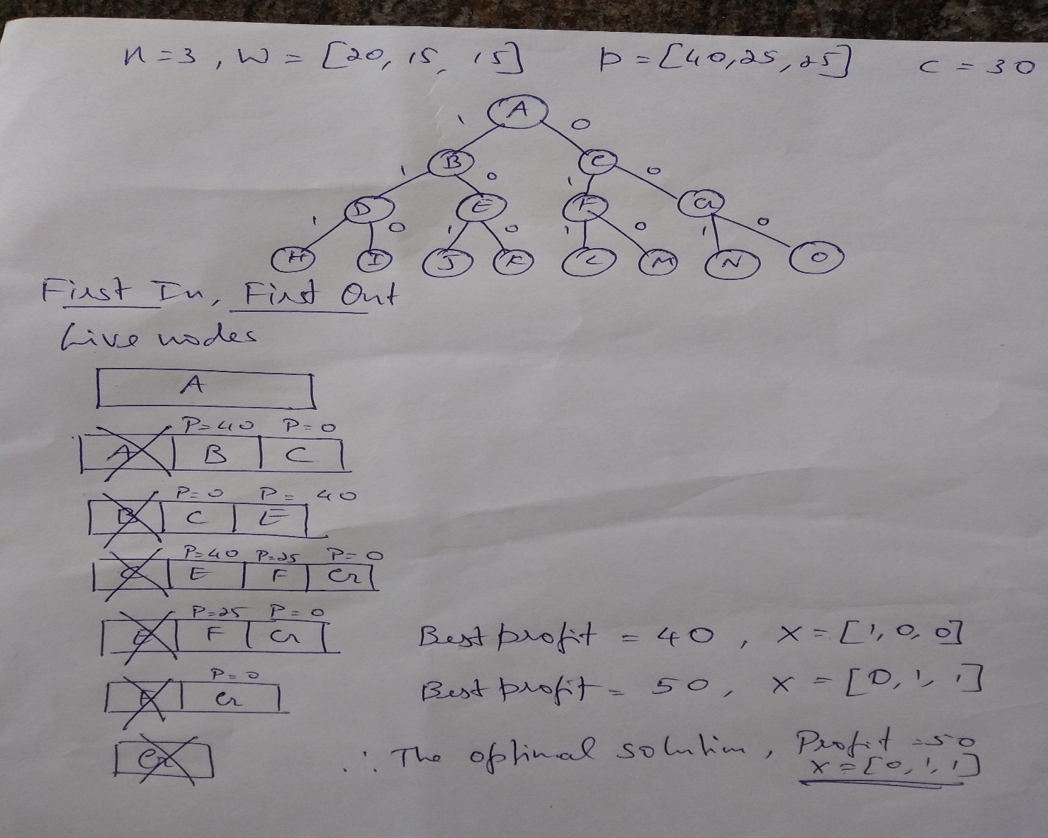
0/1 Knapsack – First In, First Out

Slide 6
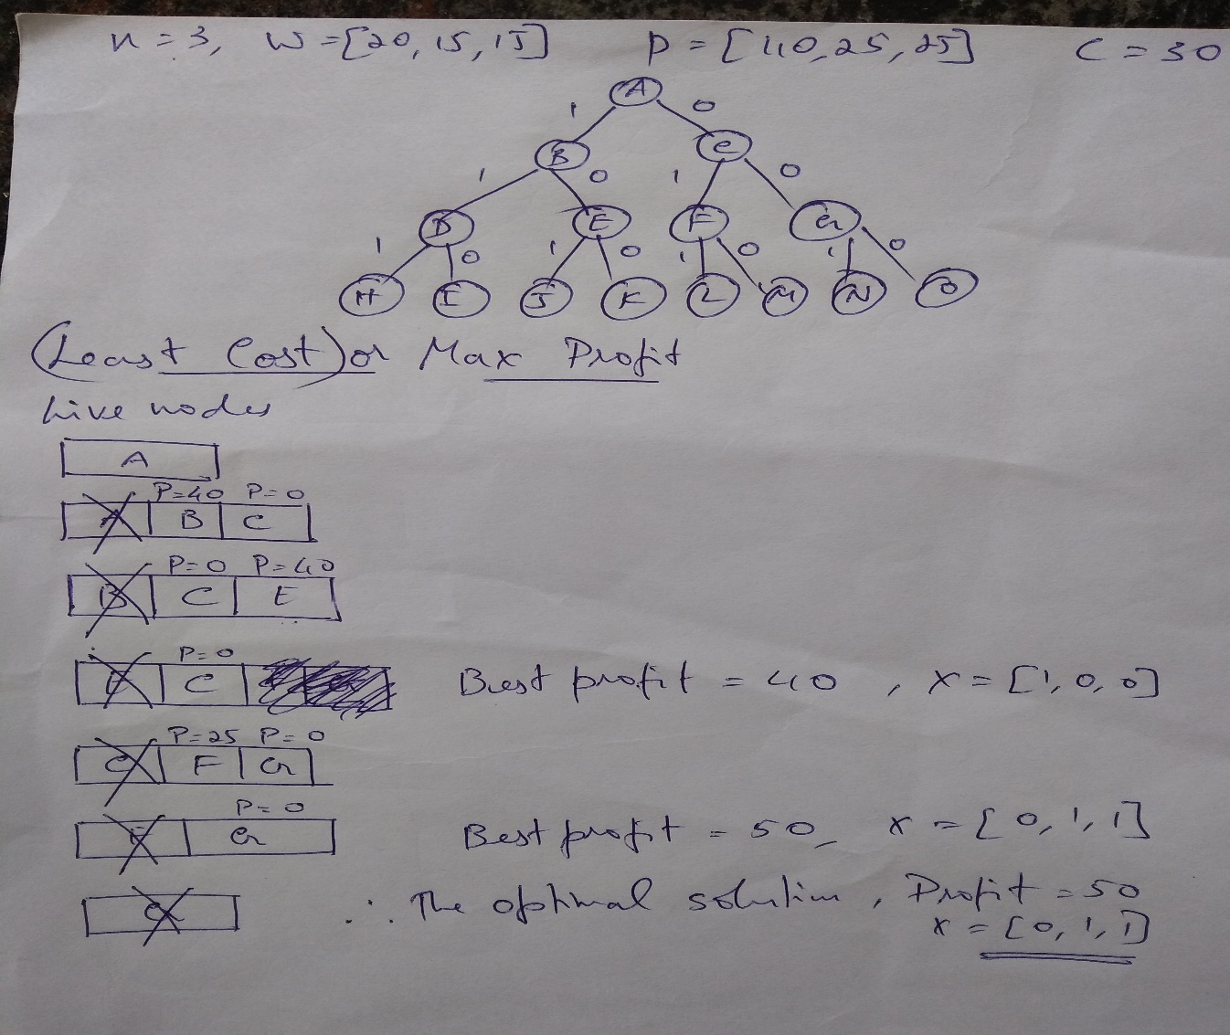
0/1 Knapsack – Max Profit

Slide 7
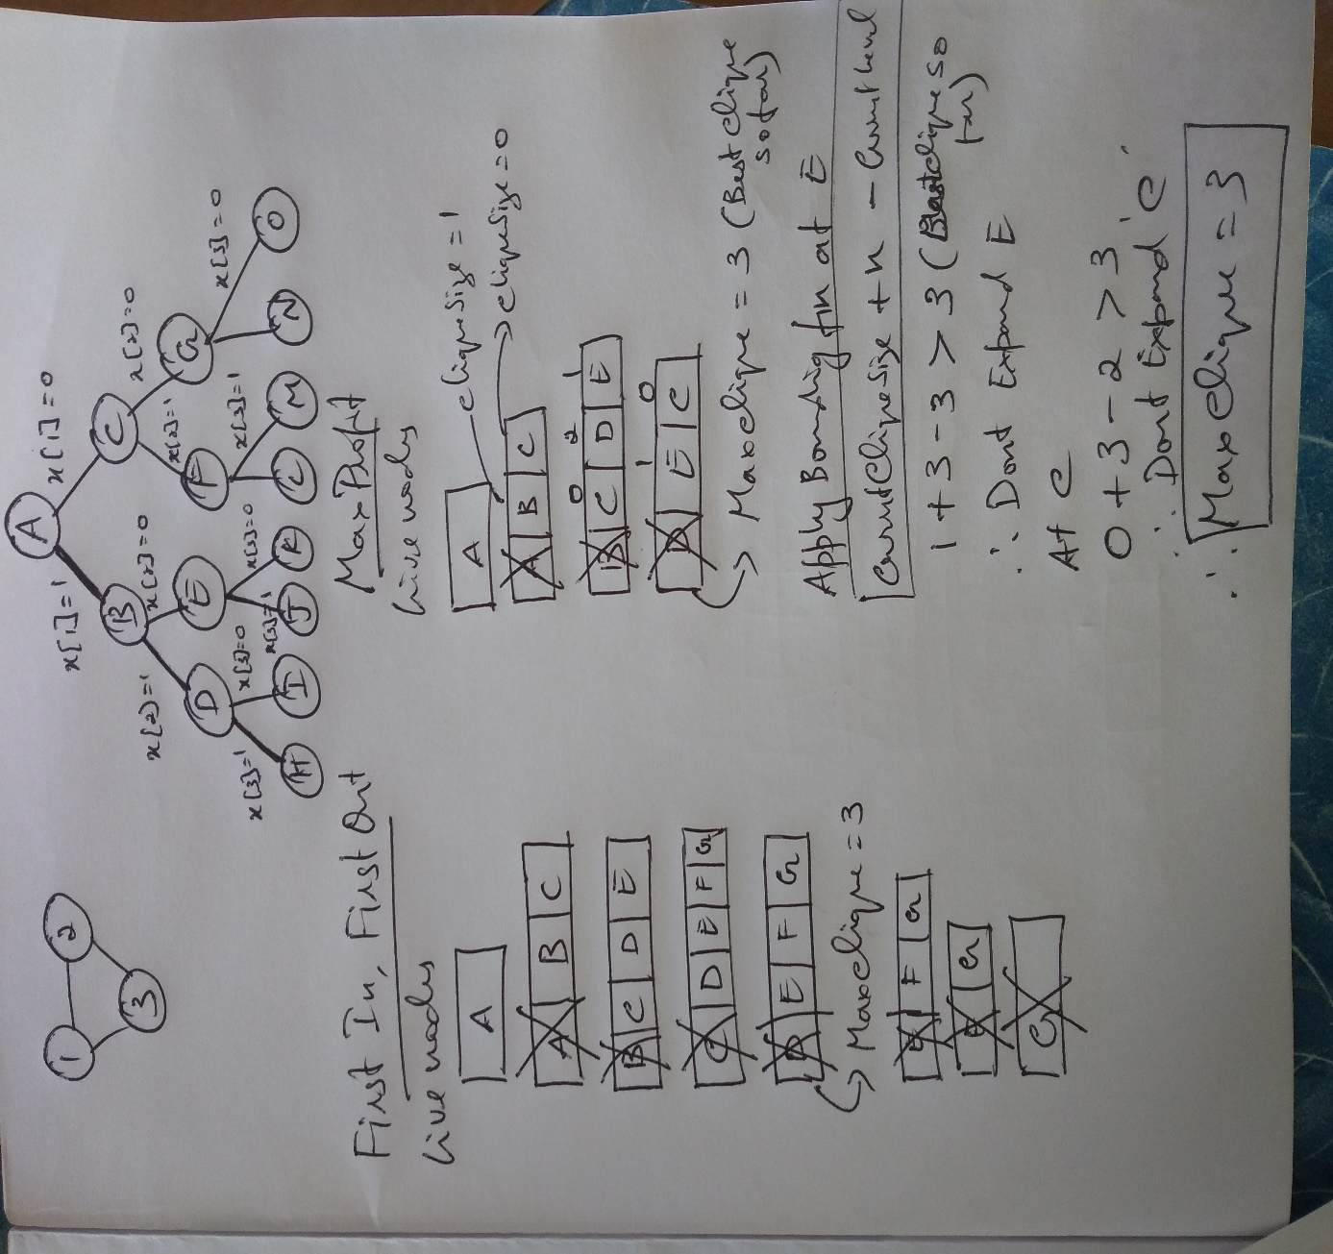
Max Clique

Slide 8
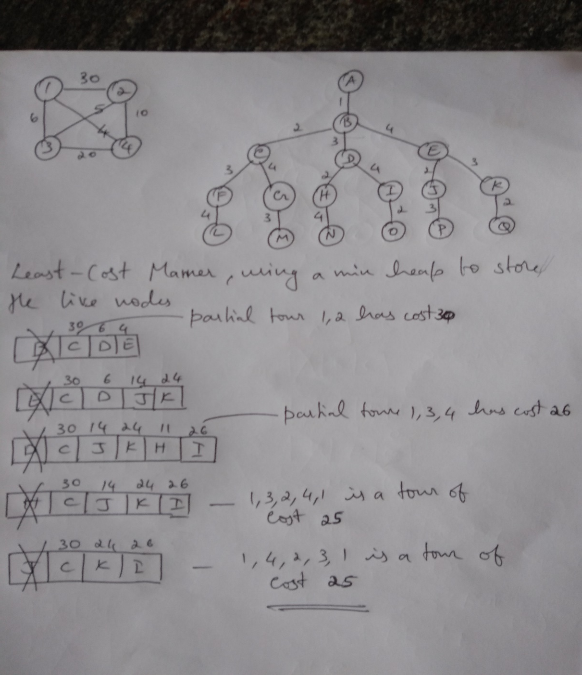
Travelling Salesperson Problem

